Slide 1

IWS VENDOR App - VENDOR FLOW DOCUMENTATION

Slide 2
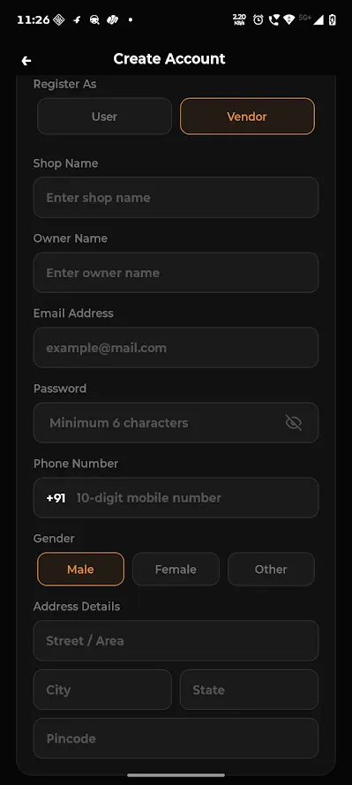
1. Vendor Registration
Vendors must first register by providing the following details:
Shop Name
Owner Name
Email Address
Password
Phone Number
After registration, the vendor account will remain in a pending state until it is verified and approved by the Admin.

Slide 3
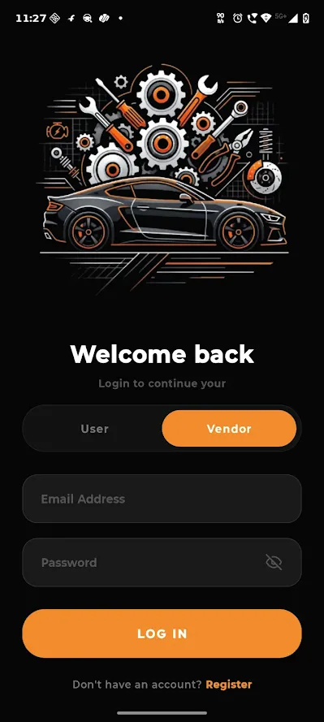
2. Vendor Login
Once the Admin approves the account, the vendor can log in using:
Email Address
Password
After successful login, the vendor will be redirected to the Dashboard.

Slide 4
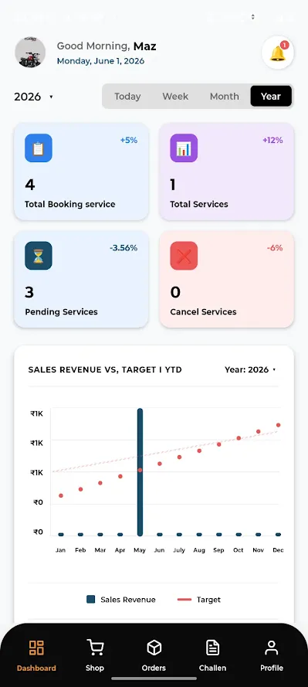
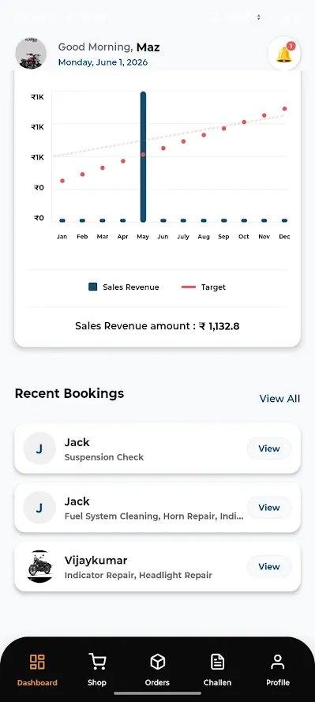
3. Dashboard
The Dashboard provides a complete overview of business performance.
Dashboard Features
Total Service Count
Pending Bookings Count
Completed Bookings Count
Cancelled Bookings Count
Total Revenue Overview
Yearly Income Chart
Recent Booking List
This helps vendors monitor daily and overall business activities.

Slide 5
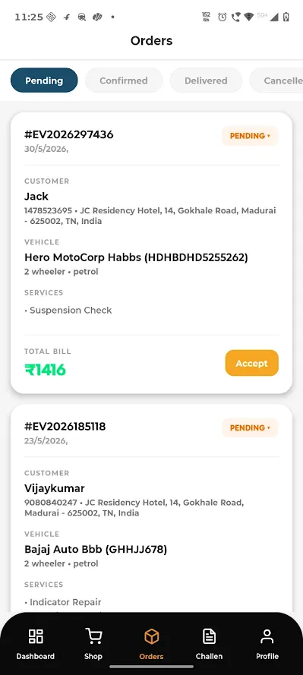
4. Booking Management
All user bookings will be displayed in the Booking Page.
Features
View Booking List
Accept Booking
Reject Booking
View Customer Details
View Vehicle Details
View Service Details
Once a booking is accepted, the booking confirmation is automatically sent to the user.

Slide 6
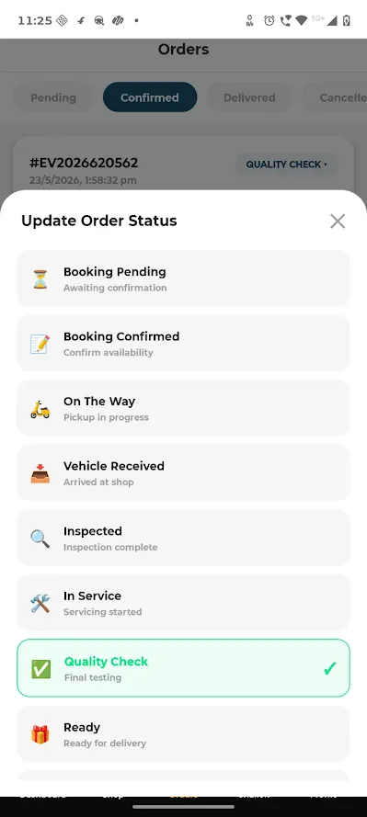
5. Service Status Update
Vendors can update booking progress at every stage.
Available Statuses
Booking Accepted
On the Way
Vehicle Picked Up
In Service
Spare Parts Processing
Ready for Delivery
Out for Delivery
Delivered
Completed
Users receive real-time notifications whenever the status changes.

Slide 7
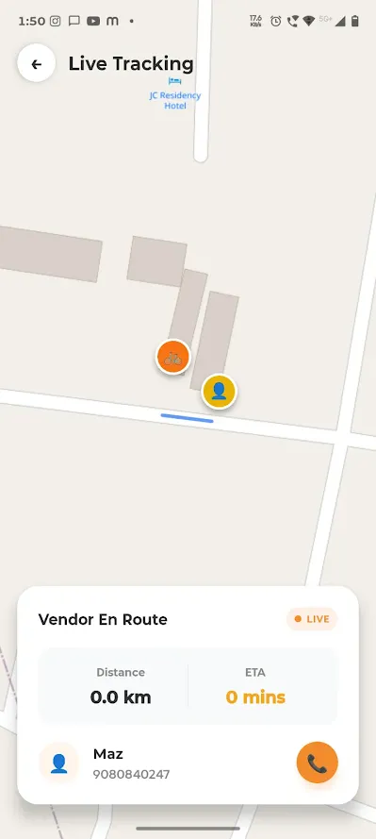
6. Live Tracking Management
After accepting a booking, live location tracking becomes available.
Features
Latitude & Longitude Tracking
Live Map Tracking
Customer Location View
Real-Time Navigation Support
Vendors can track customer locations directly through the integrated map system.

Slide 8
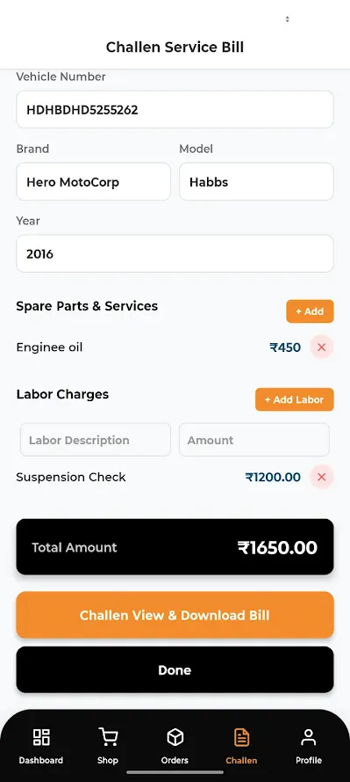
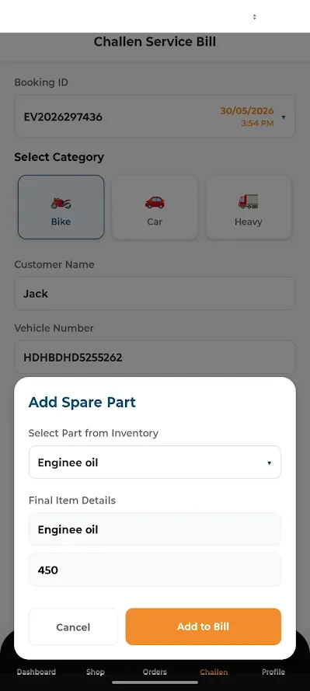
7. Billing & Challan Management
The Challan/Billing Page allows vendors to generate service invoices.
Features
Service Amount Entry
Spare Parts Amount Entry
Additional Charges Entry
Total Bill Calculation
PDF Invoice Generation
Direct Bill Sharing to User
The generated invoice can be downloaded and sent directly to the customer.

Slide 9
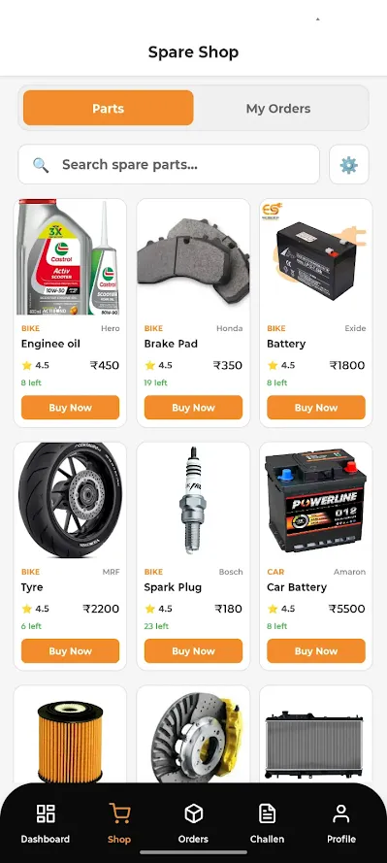
8. Spare Parts Module
The Spare Parts section allows vendors to purchase and manage spare parts.
Available Categories
Bike Spare Parts
Car Spare Parts
Heavy Vehicle Spare Parts
Features
Spare Parts Listing
Product Details View
Purchase Management
Order Tracking
Inventory Monitoring
Vendor Discount
All vendors receive a 10% discount on spare parts purchases through the platform.

Slide 10
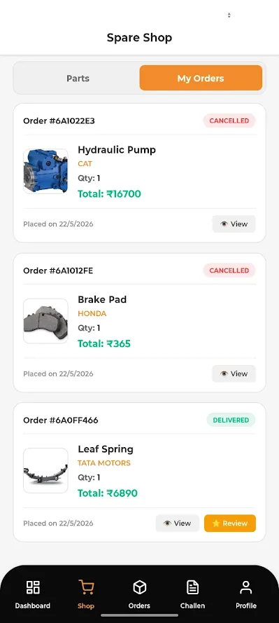
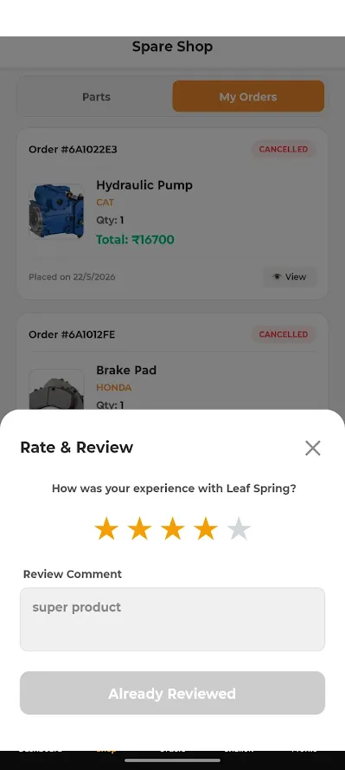
9. Orders, Reviews & Ratings
Vendors can monitor customer feedback and order history.
Features
View Orders
View Customer Reviews
View Ratings
Review Performance Tracking
This helps improve service quality and customer satisfaction.

Slide 11
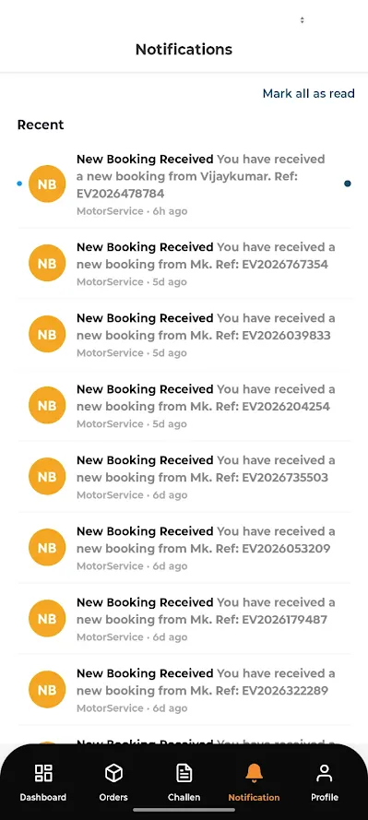
10. Notification Center
The Notification Page provides real-time updates.
Notifications Include
New Booking Alerts
Booking Status Updates
Payment Updates
Wallet Requests
System Notifications
Promotional Updates

Slide 12
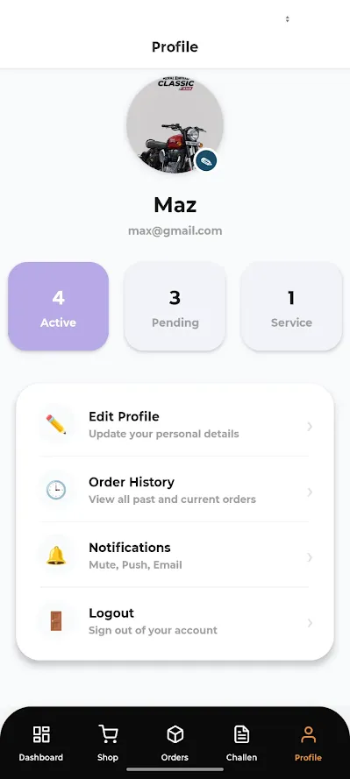
11. Profile Management
The Profile Page contains complete vendor information.
Features
View Profile Details
Edit Profile Information
Update Contact Information
Change Password
Business Information Management

Slide 13
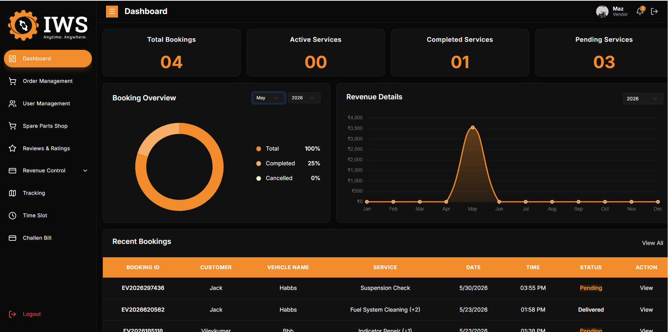
Vendor Website Panel
In addition to the Vendor Mobile App, vendors can access the same functionalities through the Vendor Website Panel.
The Vendor Panel includes:
Dashboard
Booking Management
Live Tracking
Billing & Invoice Generation
Spare Parts Management
Order Management
Reviews & Ratings
Notifications
Profile Management

Slide 14
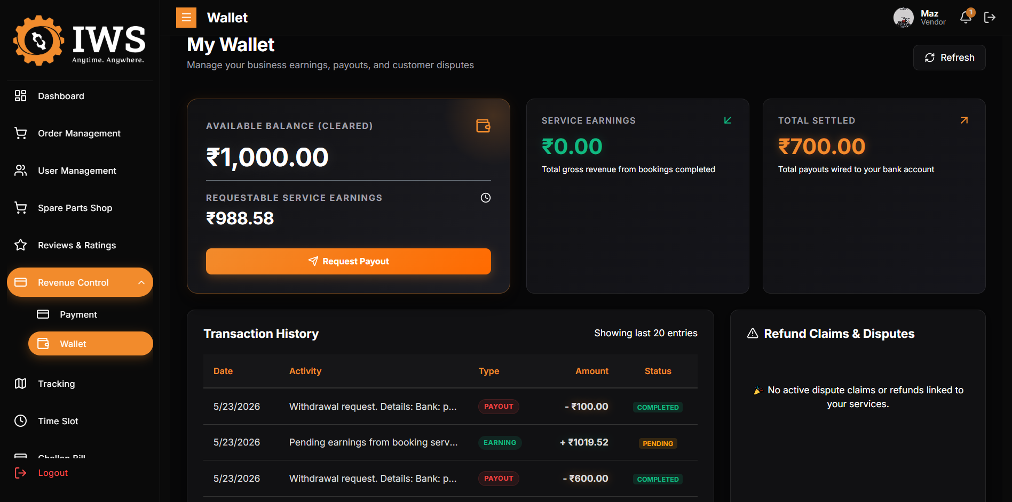
Wallet Management (Website Panel)
An additional Wallet Module is available in the Vendor Website Panel.
Wallet Features
Service Earnings Tracking
Wallet Balance View
Withdrawal Request
Request History
Received Amount History
Transaction Reports
Admin Approval Process
Wallet Workflow
Service payments are initially received by the Admin.
Vendor can submit a withdrawal request.
Admin reviews and approves the request.
Approved amount is transferred to the vendor wallet/account.
All transactions are displayed in a detailed history table.

Slide 15
Platform Availability The IWS Vendor System can be accessed through:
1. Vendor Mobile Application
Android Application
Real-Time Tracking
Booking Management
Notifications
2. Vendor Website Panel
Web-Based Management Portal
Wallet Management
Reports & Analytics
Full Business Operations Management

Slide 16
Conclusion
The IWS Vendor App and Vendor Website Panel provide a complete service management solution, enabling vendors to manage bookings, live tracking, billing, spare parts purchases, customer reviews, notifications, wallet transactions, and business performance through both mobile and web platforms. This ensures efficient operations, real-time communication, and seamless service delivery across the entire IWS ecosystem.

